Slide 1
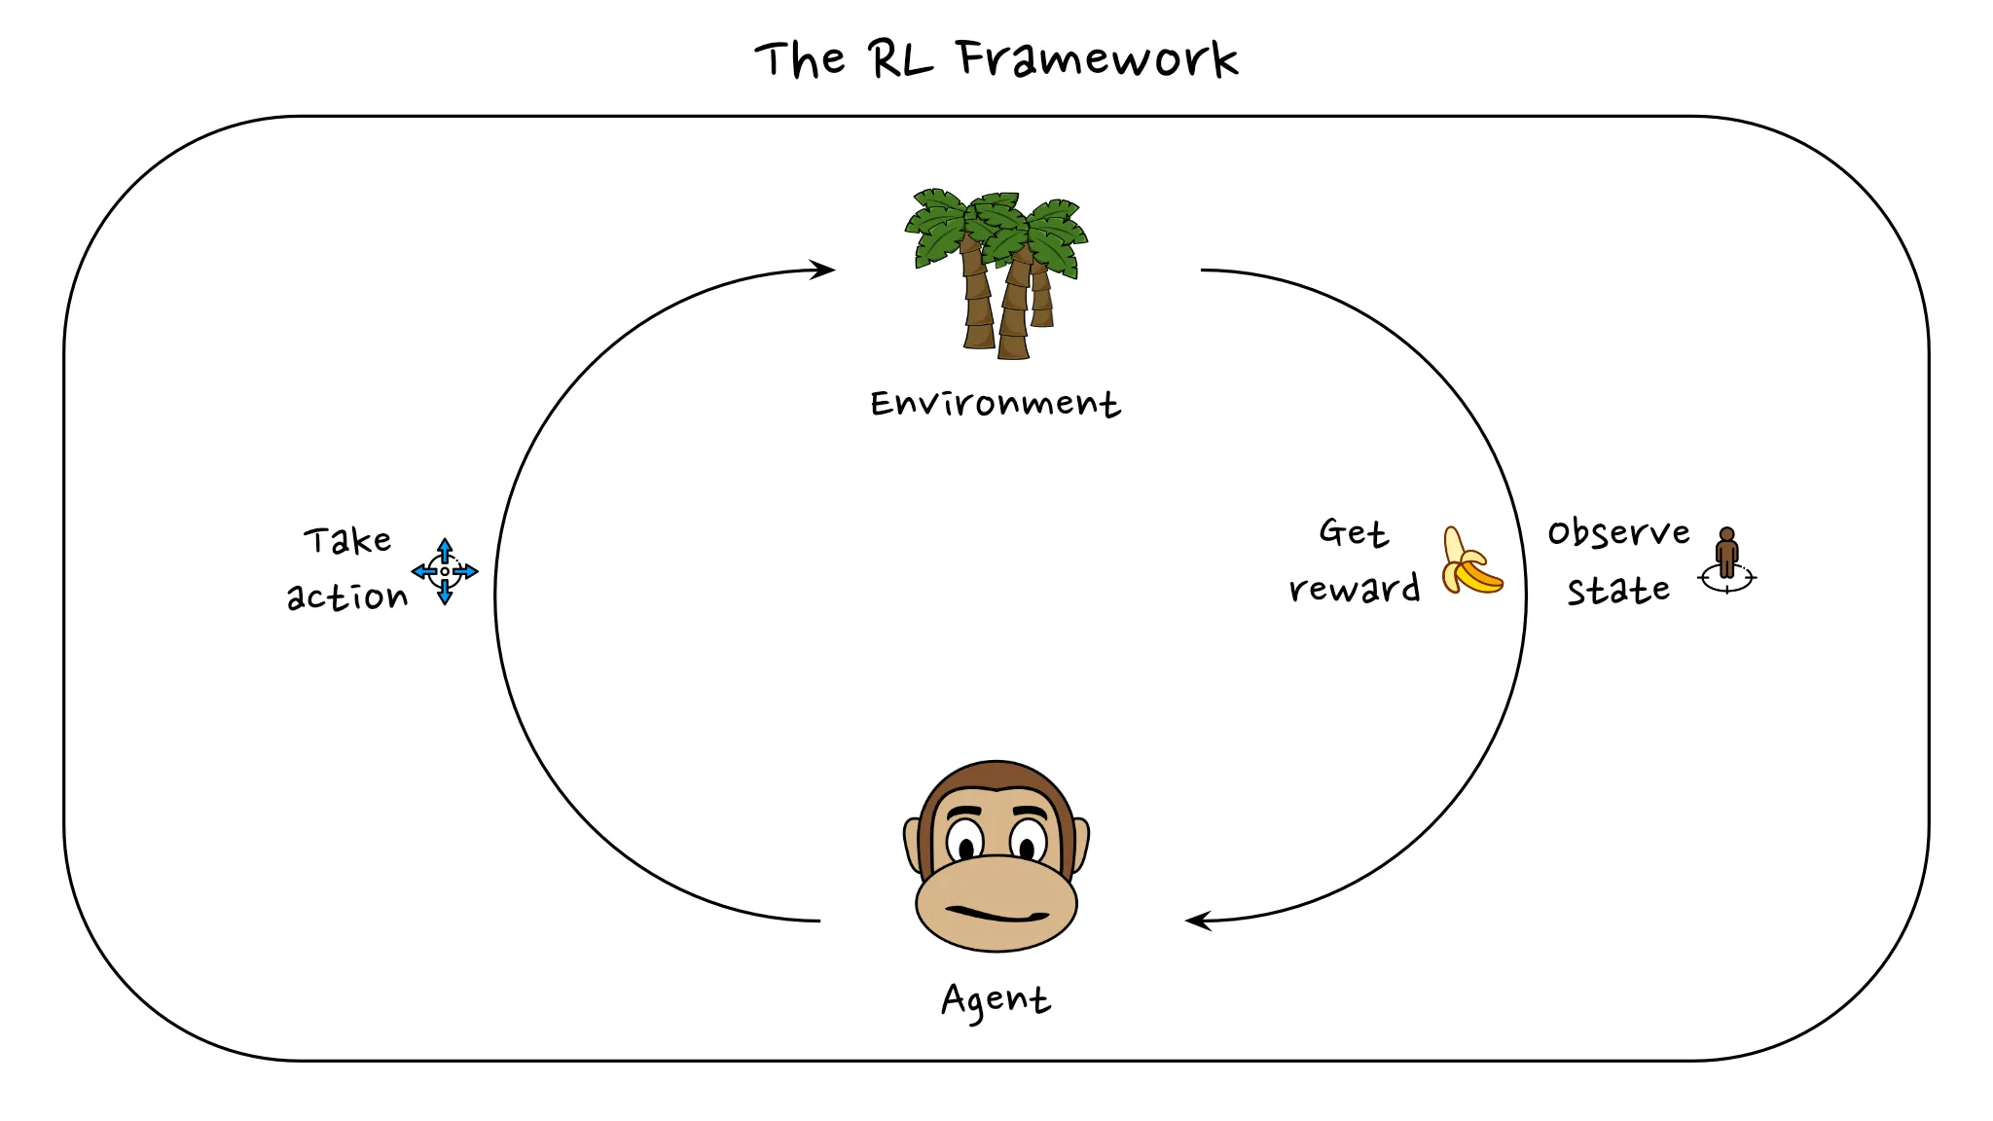
Introduction to Reinforcement Learning
Michael Mollel (PhD)
Link to the project: GitHub

Slide 2
After Presentation
What reinforcement learning (RL) is and why it is useful
RL applications in various domains like advertising, finance, healthcare, natural language processing, etc.
Key terminology in RL, such as agent, action, state, reward, and environment.
Major challenges in RL – sample inefficiency, exploration-exploitation tradeoff, sparse reward problem.
Concepts of policies (deterministic and stochastic), trajectories, returns, value functions, and Q-functions.
The Q-learning algorithm and how it works, including initializing the Q-table, choosing actions, and updating the table based on rewards received.
An example application of Q-learning to the Frozen Lake problem environment

Slide 3
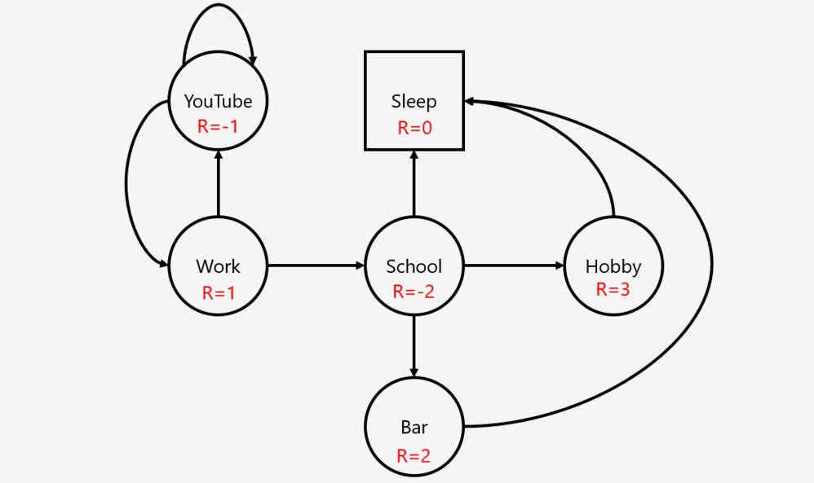
What is RL
Reinforcement learning is a framework for learning any task.
Any problem that is phrased as a Markov Decision Process (Markov Next Slide)
Why RL
RL can help us with finding novel solutions to problems, without explicitly programming tactics or solution methods.
Why is RL

Slide 4
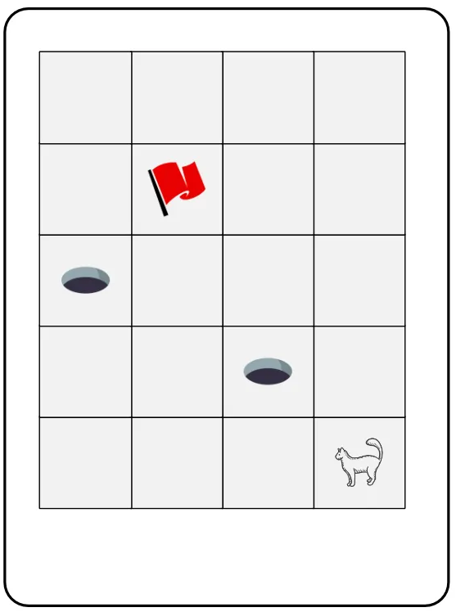
Application of RL
Advertising (The ads you see on your browser)
Finance (when to buy and when to sell)
Healthcare (Drug design)
NLP Large Language Models (Model alignment)
Agent: A thing that tries to solve a problem
Action: a decision taken by the agent
State: A circumstance that the agent sees or observe
Reward: Incentive given to agent after taking Action
Environment: a complete picture of the world
RL - Terminology and Basic
State
Environment
- Reward
Action
Agent

Slide 5

Basic Description of RL
An agent that tries to solve a task in a particular environment and state s
At every timestep t, the agent needs to choose an action a.
After this action, it might receive a reward r
And get a new observation of its states

Slide 6

Basic Branches of ML and Why RL
Supervised
Unsupervised
Semi-Supervised
Reinforcement
Answer: Yes
Challenges
Sample (in-)efficiency
The exploration-exploitation trade-off
The sparse-reward problem
RL – can be applied to all MDP Tasks
Challenges

Slide 7
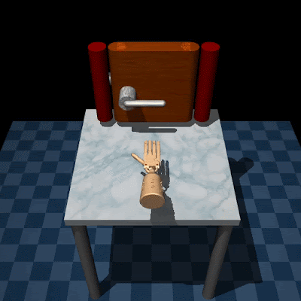
Sample (in-) Efficiency
Sample is an interaction with the environment.
Most RL Algo needs a lot of samples/interactions to be able to solve a task.
For a human, it takes a few moves to understand good moves or bad.
Human can reuse some of the knowledge and skills already acquired from other experiences throughout their life.
RL-agent in contrast, starts the learning process without any assumptions.

Slide 8
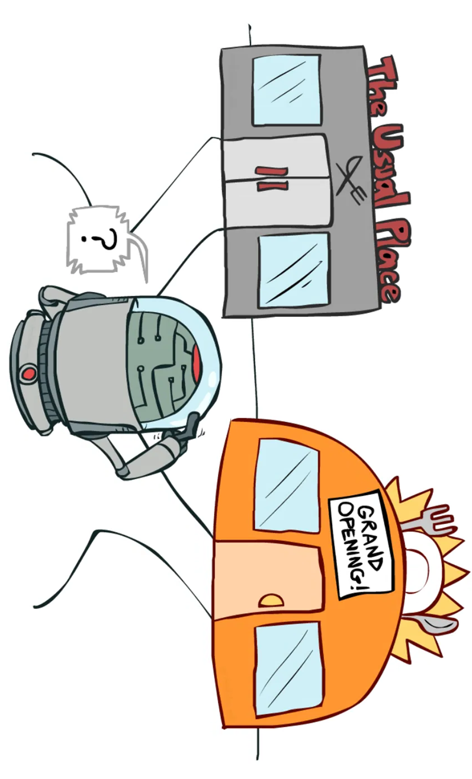
Exploration-exploitation trade-off
Choose between usual and unusual places. What if I choose an unusual place and get rich or get killed?
How often I can choose to explore the unusual place
This is the exploration-exploitation trade-off, we want an automated way to strike a good balance between letting the agent explore and taking actions for which it already knows what they will lead to.
For a lot of problems, it is quite possible that the agent gets stuck in a local optimum
One of the hardest problems for RL to solve

Slide 9
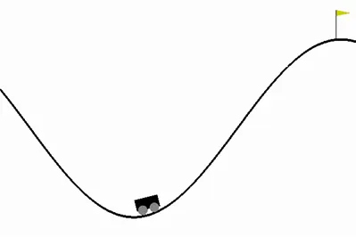
The sparse-reward problem
RL-agent receives so little rewards, that it actually gets no feedback on how it should improve.
If we only give our agent a reward (a positive feedback signal) when we have reached the flag, it might not ever get a positive feedback signal, simply because it might never reach the flag by taking random actions (exploration).
Reward shaping: modify the reward such that the agent gets more feedback signals to learn from
reward shaping is not a scalable solution
Destination
No reward being here

Slide 10
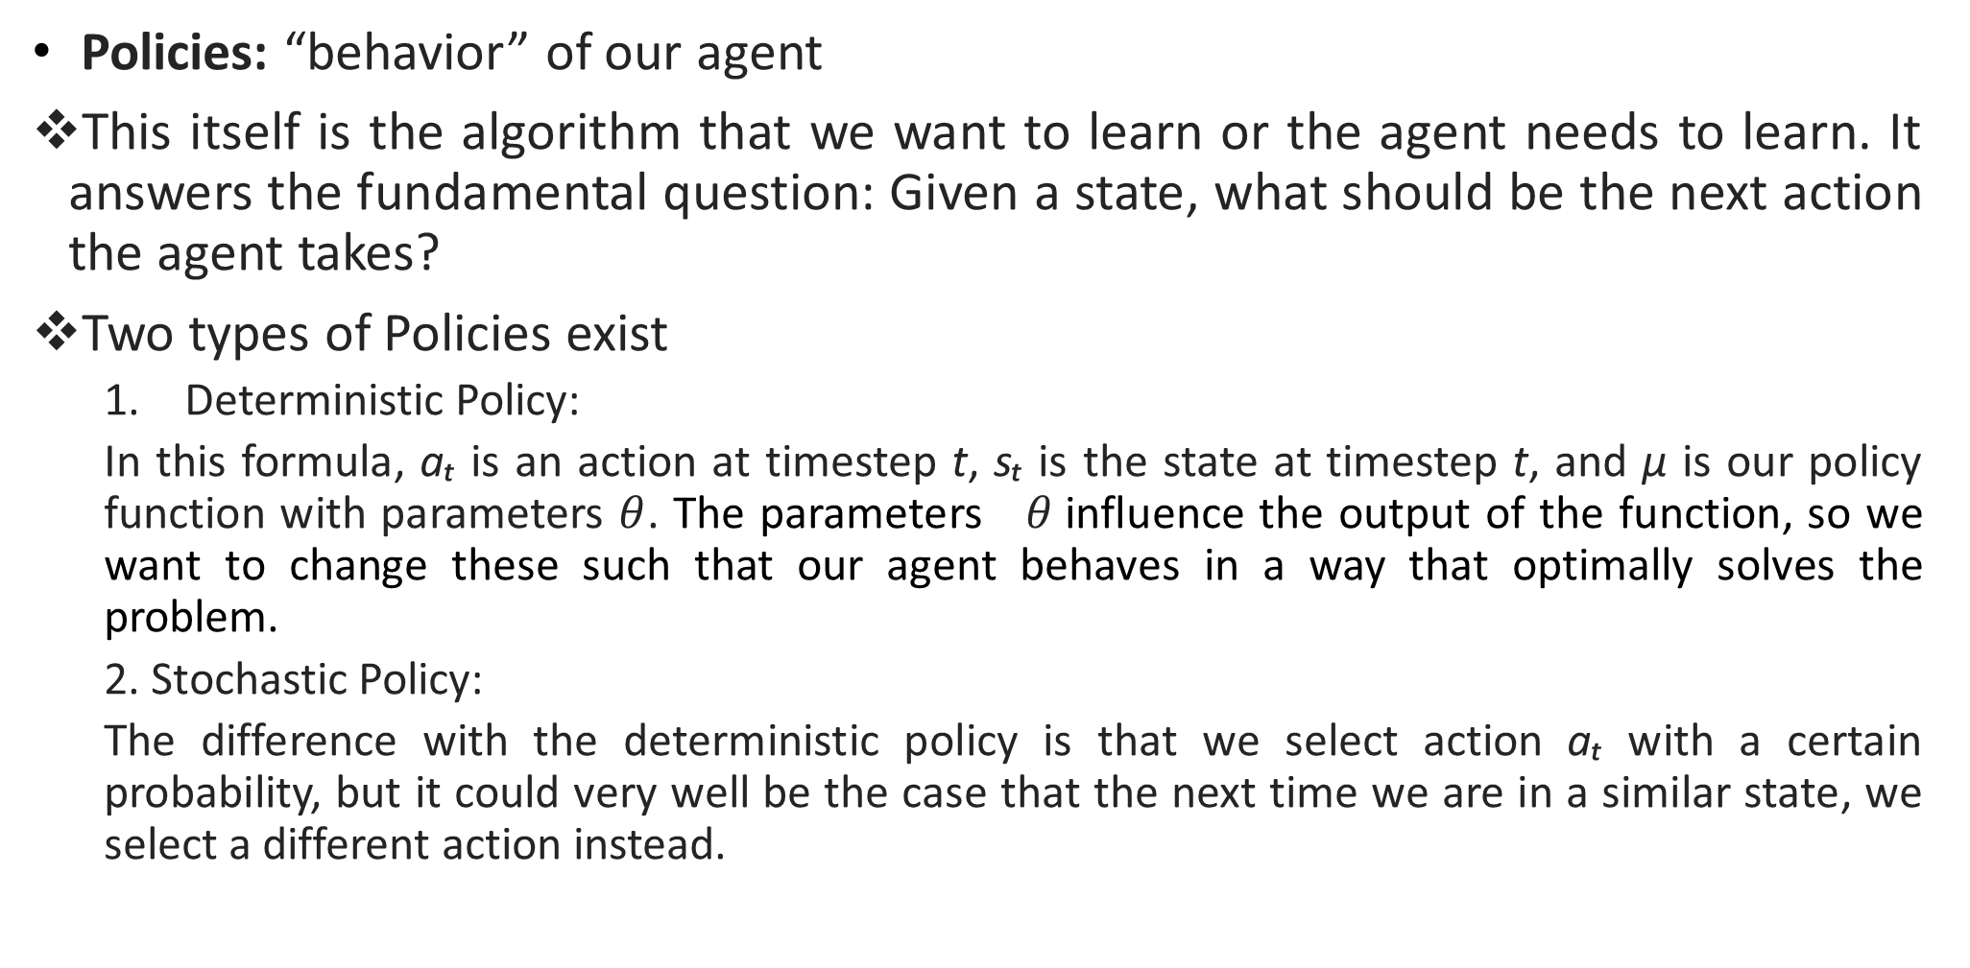
RL - Terminology Advance
Policies: “behavior” of our agent
This itself is the algorithm that we want to learn or the agent needs to learn. It answers the fundamental question: Given a state, what should be the next action the agent takes?
Two types of Policies exist
Deterministic Policy:
In this formula, aₜ is an action at timestep t, sₜ is the state at timestep t, and μ is our policy function with parameters $θ$. The parameters $θ$influence the output of the function, so we want to change these such that our agent behaves in a way that optimally solves the problem.
2. Stochastic Policy:
The difference with the deterministic policy is that we select action aₜ with a certain probability, but it could very well be the case that the next time we are in a similar state, we select a different action instead.

Slide 11
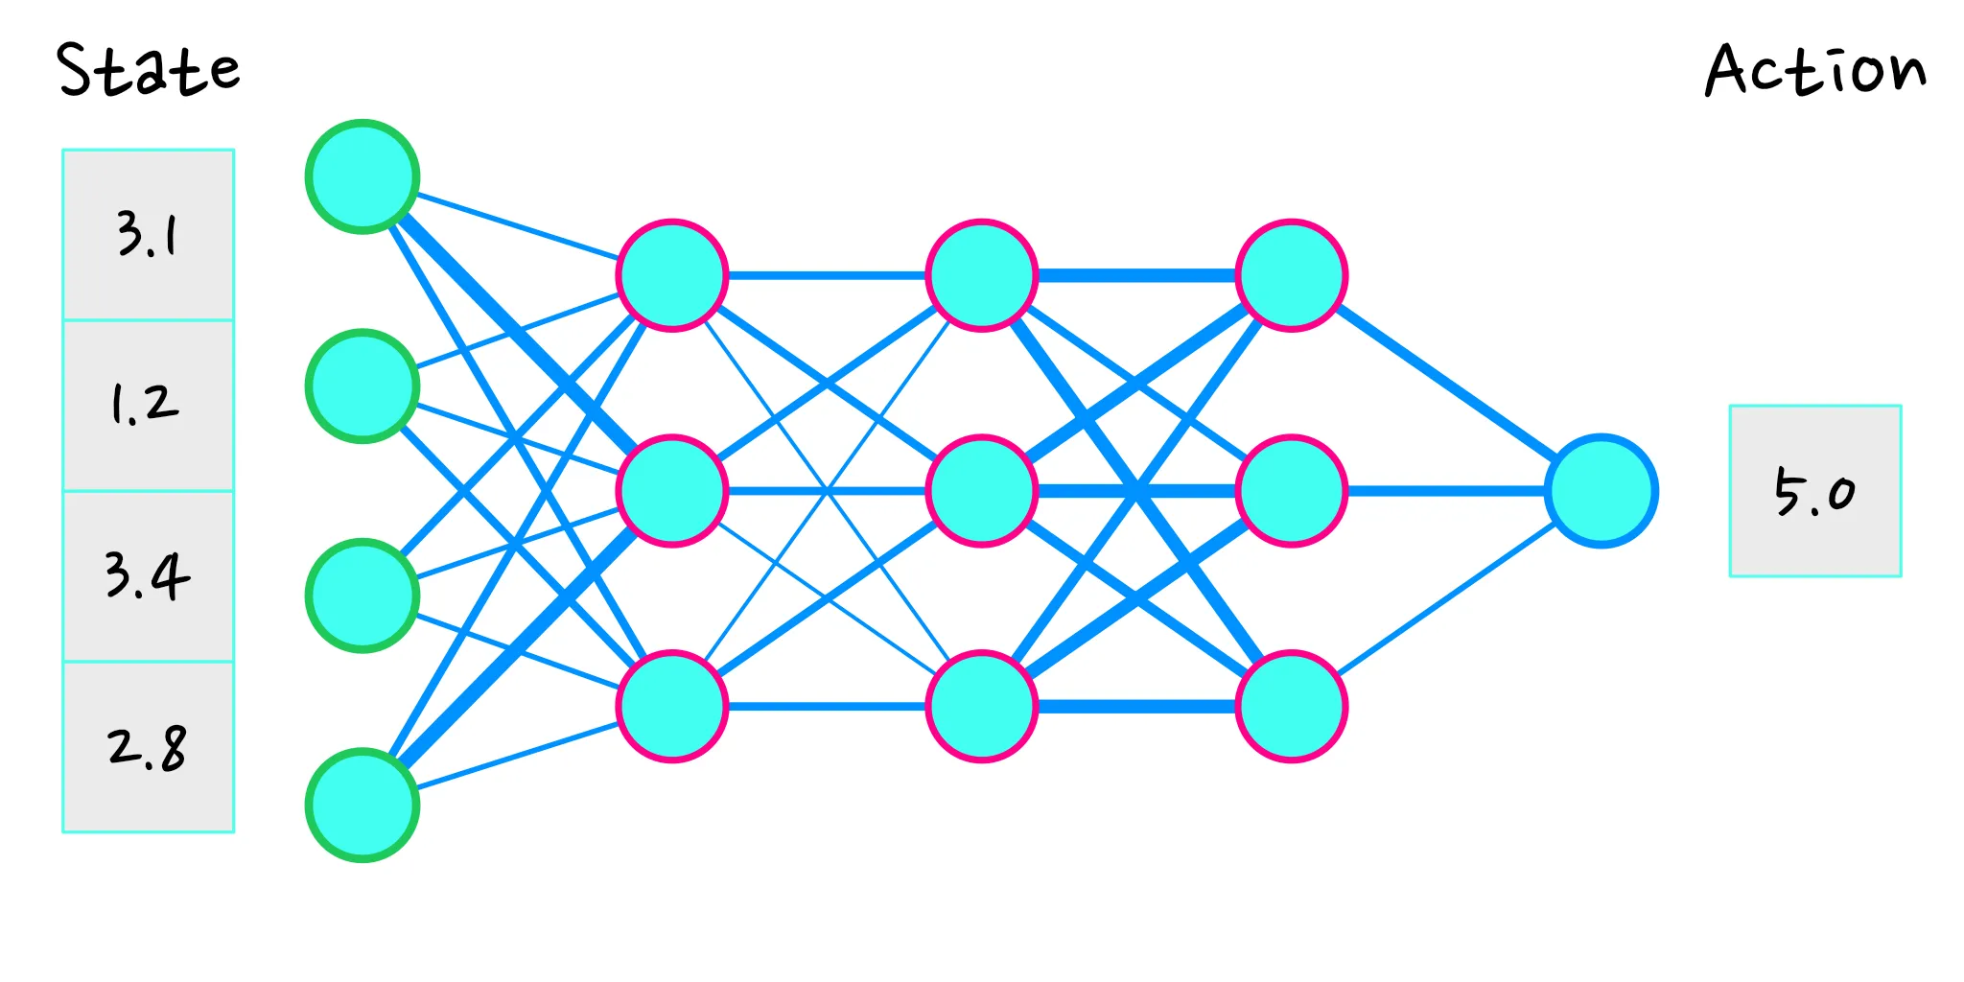
RL - Terminology Advance
Policies Example: Neural Network

Slide 12
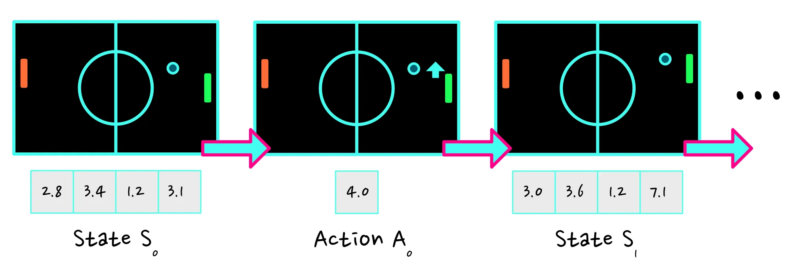
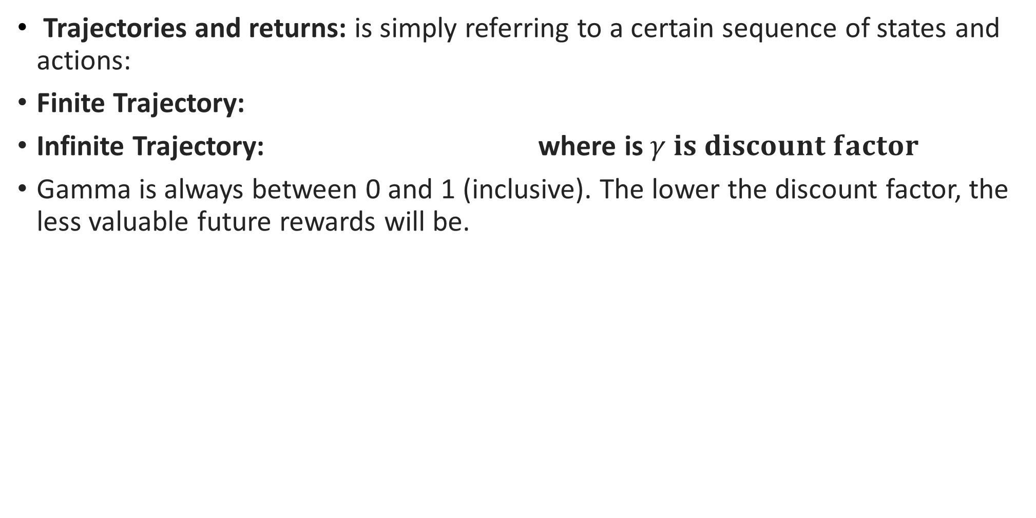
RL - Terminology Advance
Trajectories and returns: is simply referring to a certain sequence of states and actions:
Finite Trajectory:
Infinite Trajectory: where is $γ is discount factor$
Gamma is always between 0 and 1 (inclusive). The lower the discount factor, the less valuable future rewards will be.

Slide 13
Value function and Q-function
Objective: to find a policy (a behavior) for our agent such that it will receive the highest possible cumulative reward.
Value function:
The value of being in state s while acting under policy π is equal to the reward we get from the trajectory τ that we expect to follow from policy π, given that state s is the starting state (how good it is to be in a certain state).
Q- function:
The value of being in state s and taking action a, while acting under policy π is equal to the reward we get off the trajectory τ that we expect to follow from policy π, given that state s is the starting state and the first action we take is a (how good is it to be in a state and to take a certain action)

Slide 14
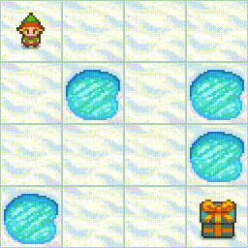
Q-function -> Q-Table -> Q-Learning
Q-learning is a model-free, value-based, off-policy algorithm that will find the best series of actions based on the agent's current state. The “Q” stands for quality. Quality represents how valuable the action is in maximizing future rewards.
Frozen Lake Problem

Slide 15
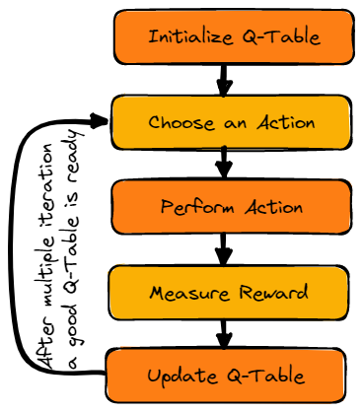
Q-Table
The agent will use a Q-table to take the best possible action based on the expected reward for each state in the environment. Simply put, a Q-table is a data structure of sets of actions and states, and we use the Q-learning algorithm to update the values in the table.
Q-Learning Algorithm

Slide 16
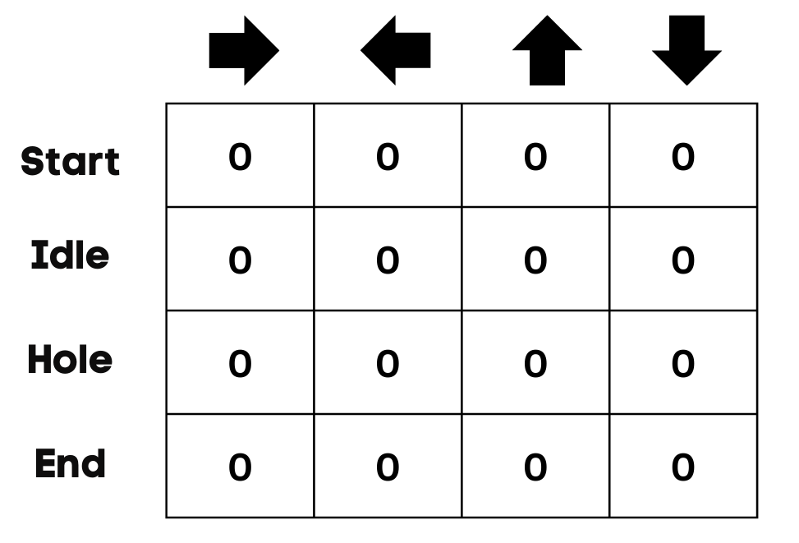
Initialize Q-Table
first, initialize the Q-table. We will build the table with columns based on the number of actions and rows based on the number of states.
Q-Table Initialization ()

Slide 17
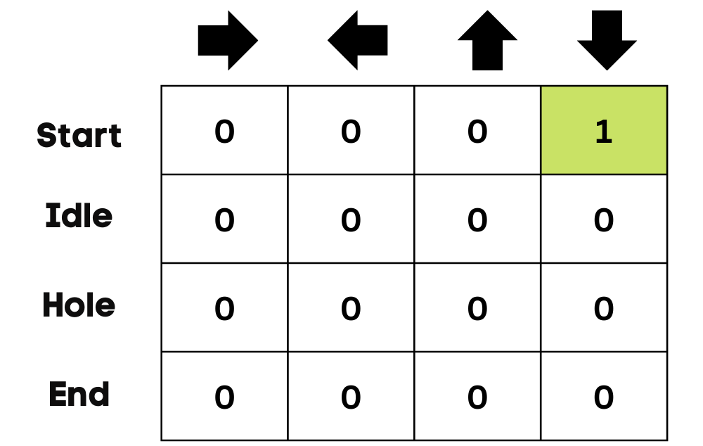
Choose and Action
At the start, the agent will choose to take the random action(down or right), and on the second run, it will use an updated Q-Table to select the action.
Apply Action and Update Table

Slide 18
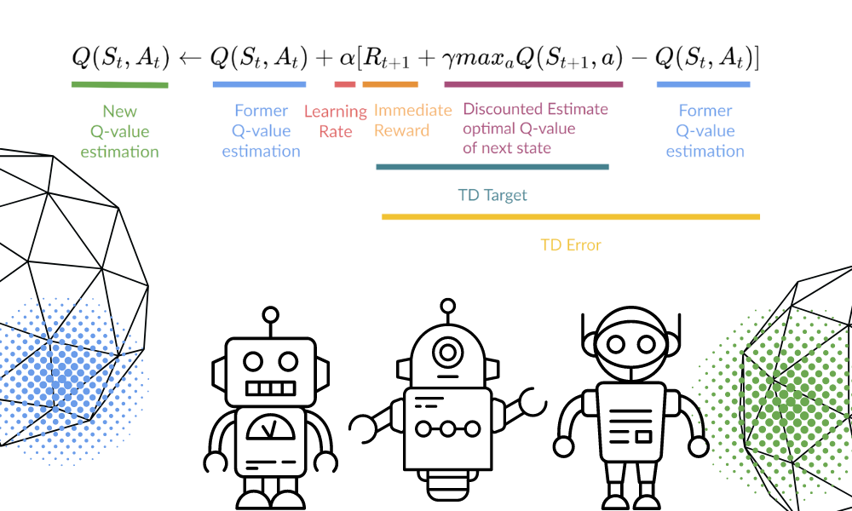
The Update Function

Slide 19
What left: Practice and More lectures

Slide 20
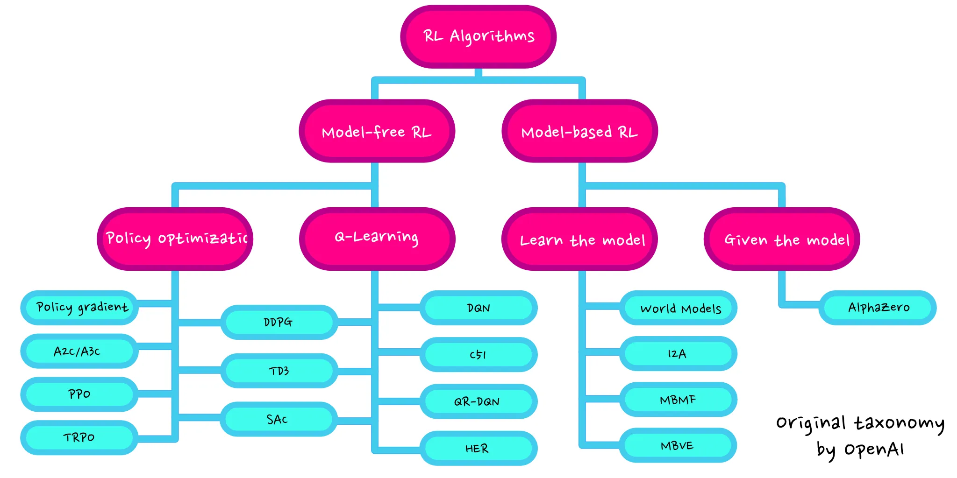
Group of RL Algorithm

